Slide 1
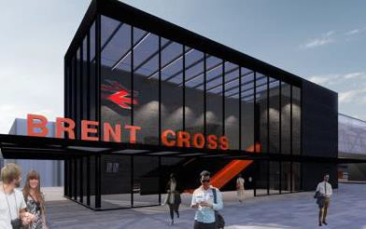
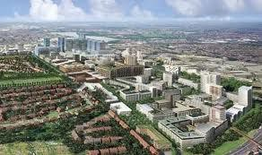
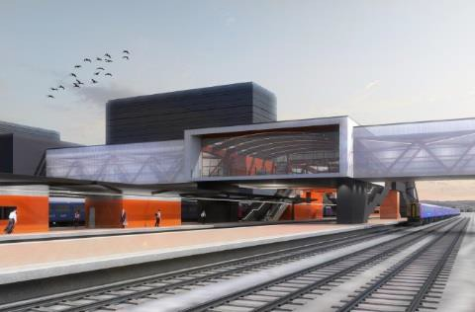
Brent Cross West station
Residents Update
7th February 2019

Slide 2
Introductions
Samantha Wadsworth – Programme Director
Sidings
Sarb Dhillon – Sidings Project Sponsor (Re Ltd)
Scott Louder - Network Rail senior programme manager
Accommodation Block
Barry Wims – TOC Project Sponsor (Re Ltd)
Jimmy Sexton - Graham Project Manager

Slide 3
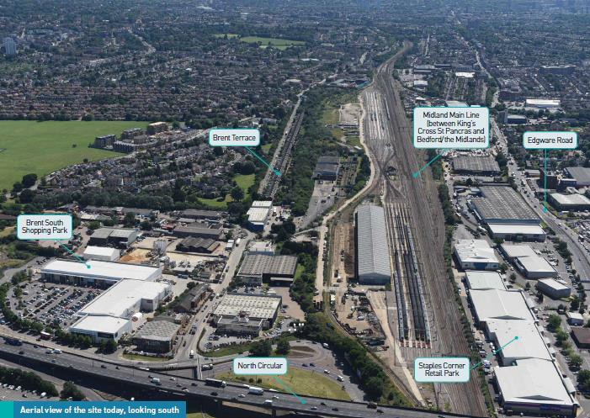
Agenda
Project status
Upcoming Works
Rest of programme
Next steps
Q&A

Slide 4
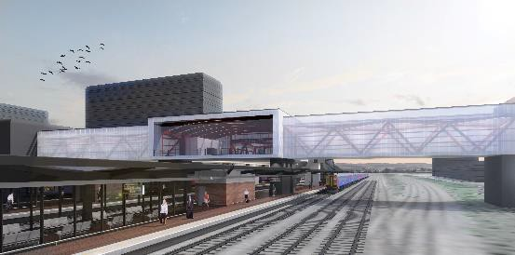
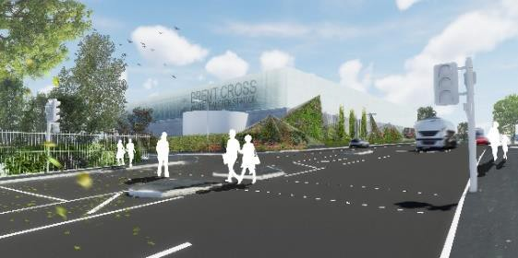
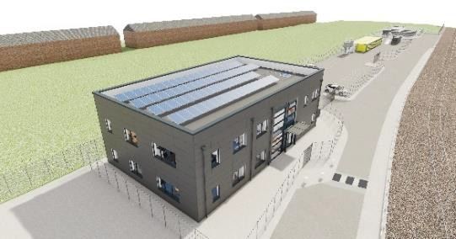
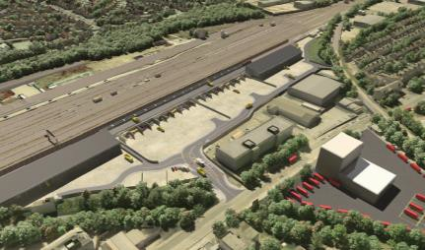
BXT packages and overview
Thameslink Sidings
Freight Facility
Thameslink Station
NLWA
Brent Cross West station
Replacement waste transfer station
Sidings & train crew accommodation
Rail freight facility
Notes:
Quick update on the overarching Brent Cross Thameslink scoping and planning status. BXT consists of 4 distinct projects / geographical areas:
The new Brent Cross West station, which we are here to discuss today
Relocation of existing sidings and associated Train Crew accommodation, which is required to make space for the construction of the station. These works have planning permission and have now commenced on site. These works are all on private railway land and therefore have not been presented to the CAF.
New Rail Freight Facility, which has planning permission and is currently being constructed by DB Cargo. These works are also on private land with no public access.
Replacement Waste Transfer Station, which also has planning permission. Demolition of the existing Selco site is due to commence in the next few weeks prior to construction of the new facility commencing. There are some highways improvement works associated with the WTS, relating to the junction between Geron Way and the A5. Sam to add details if needed

Slide 5
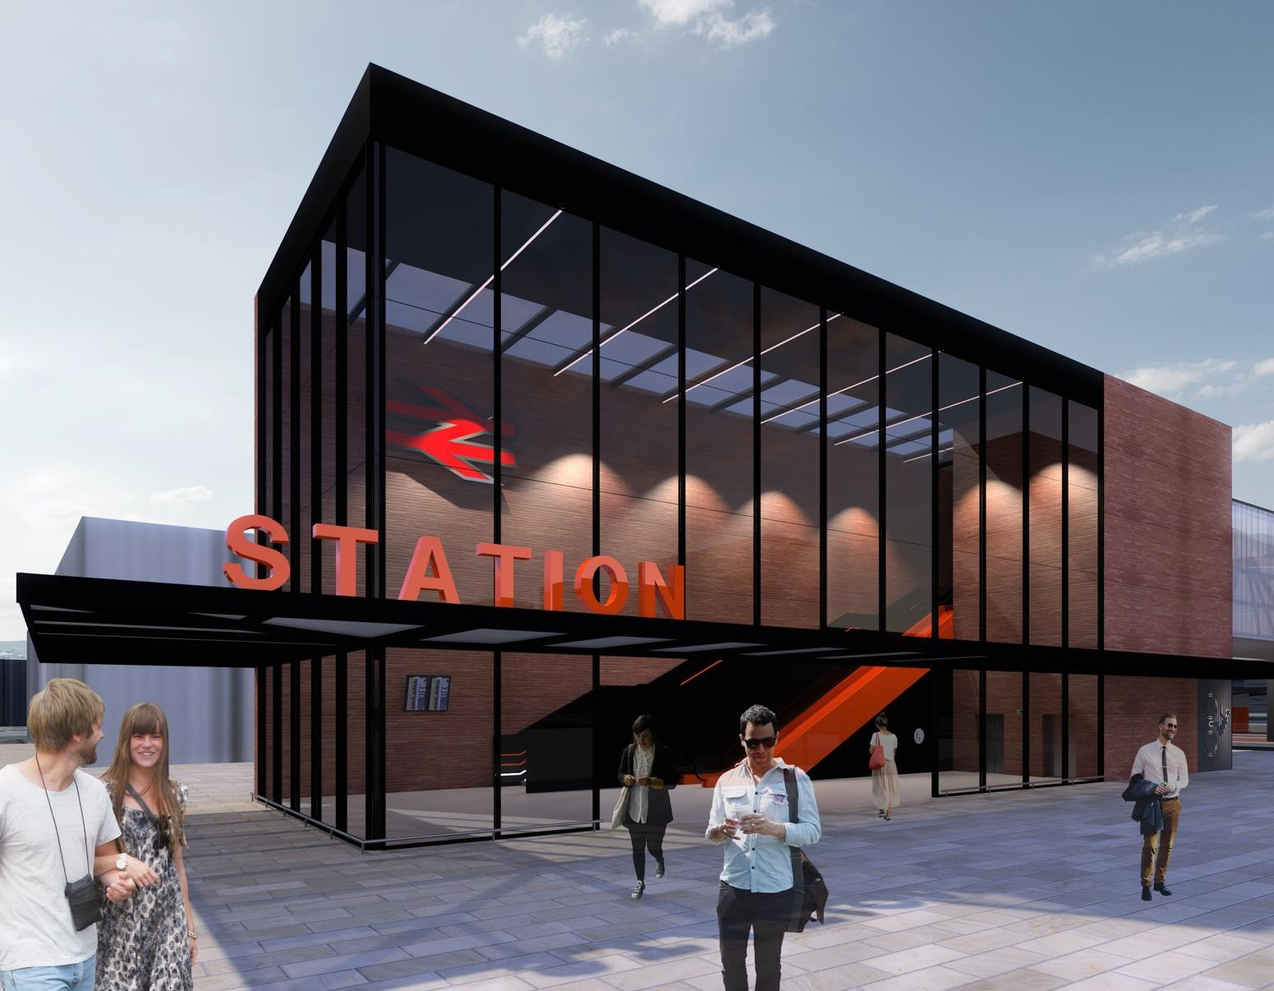
Brent Cross West station status
Design approved by NR
Final planning submission in April
LBB to appoint contractor to build station (Sep 2019)
Station to open by May 2022

Slide 6
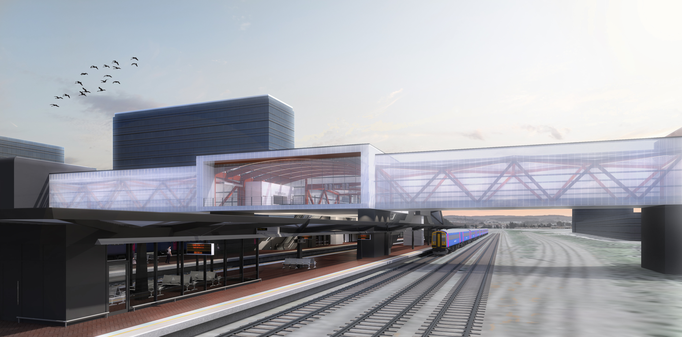
Programme
Our Programme
2019
February- Sidings and TOC Start of Works
March- Waste Transfer Start of Works
August – Train Personnel Accommodation Complete
September -Fuel Farm Commissioned
November- Sidings Commissioned
2020
May- Station Construction Start
2022
May -Brent Cross West Station Opening

Slide 7

The Scheme aims to improve the image of construction
General public
We do all we can to reduce the impact of construction activity on anyone affected by our work, and aim to leave a positive impression on our neighbours.
Workforce
We will do all we can to be a considerate employer. We will provide clean and appropriate facilities for all those who work for us, and treat every employee with respect.
Environment
We will do all we can to reduce any negative impact on the environment, and work in an environmentally-conscious and sustainable manner.
Our projects will have a Community Liaison Officer able to provide a direct point of contact with the public in office hours

Slide 8
Sidings Update
Scott Louder
Network Rail snr programme manager

Slide 9

Brent Cross Thameslink Project
Rail Systems Works

Slide 10
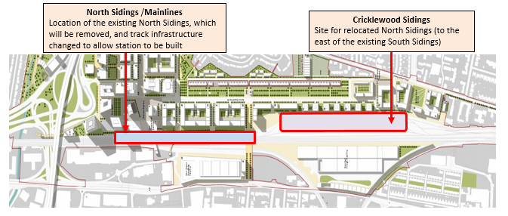

What we are doing
Managed by Network Rail
Contractor Amey
- Built previous Thameslink sidings ( As Carillion)
- Worked closely with the local community during this project to help improve the Millennium Green

Slide 11
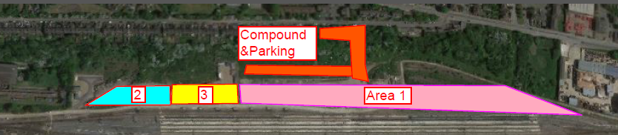
When we are doing it
Phase 1
New South sidings
Phase 2
Mainline Track works
Phase 3
Final commissioning works
November 2019
August 2020
February 2021
Compound Set up
Start Area 1
Start Area 2
Start Area 3
Bring into use
February 2019
February 2019
May 2019
August 2019
November 2019

Slide 12
Schedule of works
Dates (Week commencing) | Work
16th February | Remove Spoil by Train, Install Brent Terrace access gate
23rd February | Remove Spoil by Train, Compound set up
2nd March | Install New Overhead Line Switch
9th March | Install new track connection to Departure Rd
16th March | Remove Spoil by Road / Train, Commence Piling
23rd March | Commence Installation of walkways, Continue Piling
30th March | Continue Installation of walkways, Continue Piling
6th April | Deliver Materials by Train
13th April | Deliver Materials by Train
20th April | Install new track connections for the new sidings
27th April | Tamp 1000 points

Slide 13
Overnight & Weekend works
Date | Time of works
Sat 16th to Sun 17th Feb | 0730 - 2200
Sat 23rd and Sun 24th Feb | 0800 – 1700
Sat 2nd and Sun 3rd Mar | 0800 – 1700
Mon 4th to Tue 5th Mar | 2320 - 0430
Tue 5th to Weds 6th Mar | 2320 - 0500
Wed 6th to Thu 7th Mar | 2320 - 0515
Thu 7th to Fri 8th Mar | 2320 - 0500
Sat 9th to Sun 10th Mar | 0730 - 2200
Mon 11th to Fri 15th Mar | 2315 - 0500
Sat 16th and Sun 17th Mar | 0800 – 1700
Tue 19th to Sat 23rd Mar | 2300 - 0530
Sat 23rd to Sun 24th Mar | 2300 - 1800
Sat 30th Mar | 0800 – 1700
Sun 31st Mar | 0300 - 1700
Sat 6th to Sun 7th Apr | 0730 - 2200
Sat 13th and Sun 14th Apr | 0800 – 1700
Tue 16th to Wed 17th Apr | 2320 - 0500
Wed 17th to Thu 18th Apr | 2320 - 0515
Thu 18th to Fri 19th Apr | 2320 - 0545
Sat 20th and Sun 21st Apr | 0800 – 1700
Mon 22nd to Sat 27th Apr | 2330 - 0545
*Orange highlighted works are Night time

Slide 14
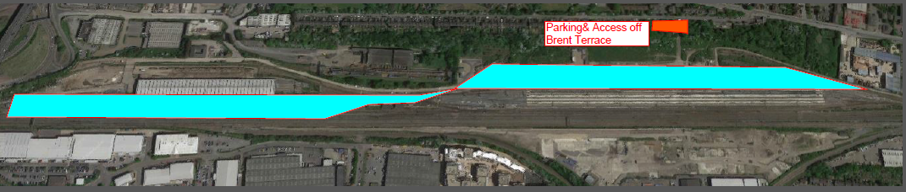
Activities that may impact residents
Piling work
Night time construction
Site lighting
Night time deliveries via train
Increased vehicular access via Brent Terrace

Slide 15
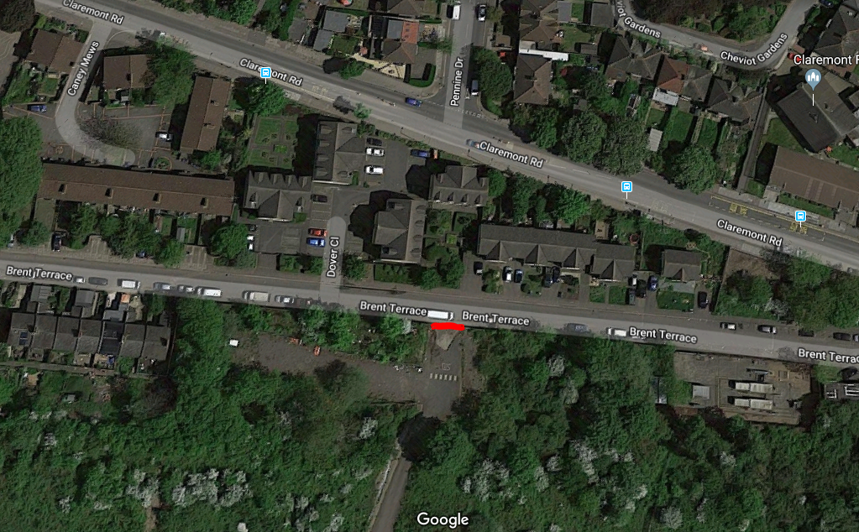
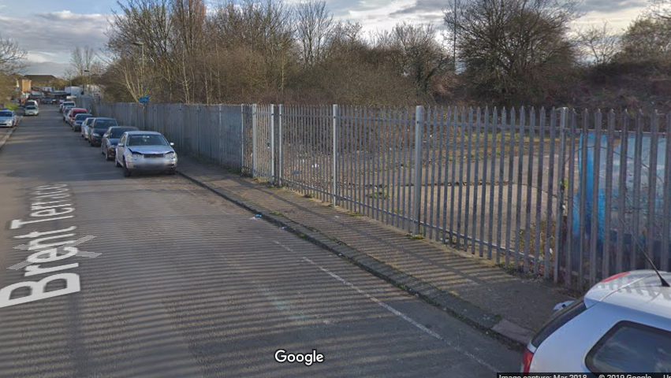
Brent Terrace access gate
New gate being installed off Brent Terrace to give access to site
Planned installation/ use for Monday 18th February
Only cars and Vans- No HGVs
Security guard will be present 24/7

Slide 16
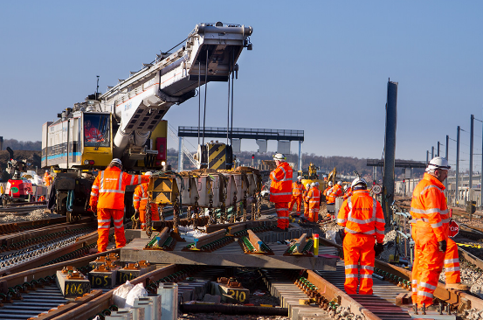
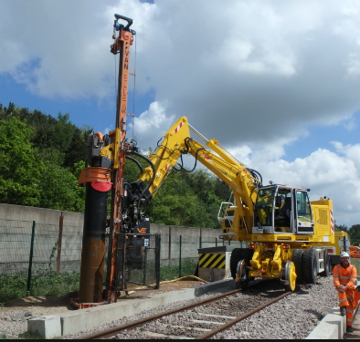
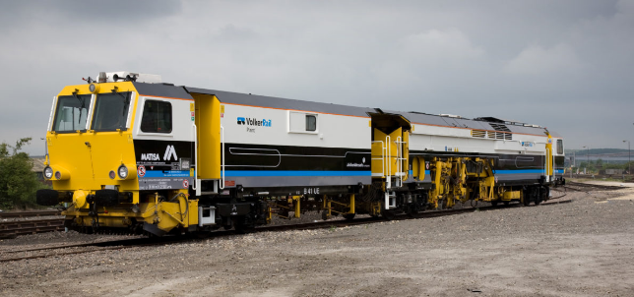
Construction Equipment examples
Kirow Crane
Piling machine
Tamper

Slide 17
Mitigations
Noise
Noise screening where practicable
Piling rig to be shrouded to reduce noise levels and noisy equipment to be sited as far from residents as possible
Turning off engines/equipment when not in use
Use of low noise/hybrid equipment where available and practicable
All staff briefed on considerate behaviour
Lighting
Task specific lighting
Only lighting up wider areas if required for Health & Safety
Directing lights away from residential properties as much as possible
Use of appropriate lux levels, LED or hydrogen powered lighting
Use of lighting shields on individual tower lights to reduce spillage
Traffic - Brent Terrace
No HGVs allowed through Brent Terrace,
No parking on Brent Terrace – contractor will monitor and enforce
Amey will be registered under the Considerate Constructors Scheme

Slide 18

How to contact us
Letter will be received within the next few days for Weekend and night time working
Bi-monthly residents letter – next due for May/June work
Community liaison officer will be appointed shortly and contact details will be informed to residents

Slide 19
Train Staff Accommodation
Barry Wims (Re Project Sponsor)
Jimmy Sexton (Graham Construction Ltd)

Slide 20
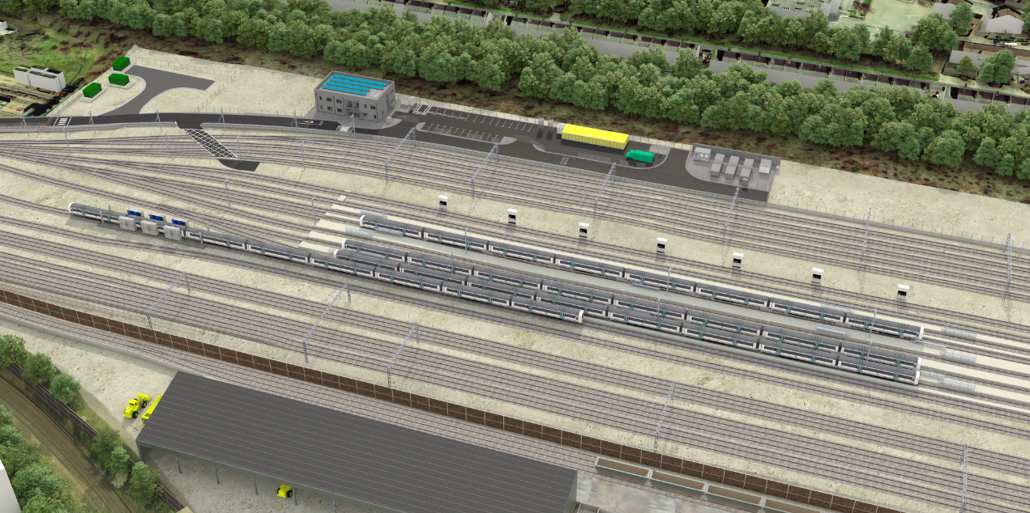
Brent Cross Thameslink Project
TOC Compound Overview

Slide 21
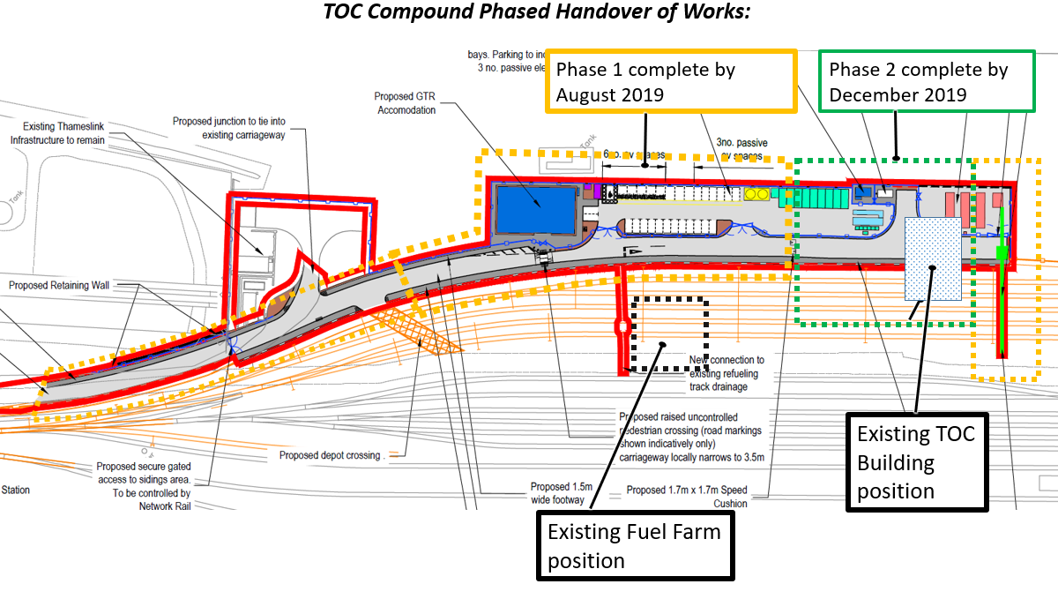
Brent Cross Thameslink Project
TOC Compound Phases

Slide 22
Schedule of Works
Dates - Week commencing | Work
18th February | Piling commences, excavation for drainage
23rd February | Piling continues, removal of spoil offsite, concrete deliveries
2nd March | Piling complete, Foundation install for TOC building, utilities install, concrete deliveries.
9th March | Excavations and utilities install, concrete deliveries.
16th March | Foundation install to TOC building, drainage works, concrete deliveries.
23rd March | Foundations complete to TOC building. Modular units deliveries for TOC building, Crane set up.
30th March | Foundations complete to TOC building. Modular units deliveries for TOC building, Crane set up.
6th April | Modular units install onsite, utilities install.
13th April | TOC building fit out onsite, utilities install, preparation of fuel farm temporary tank area.
20th April | TOC building fit out onsite, utilities install, preparation of fuel farm temporary tank area.
27th April | TOC building fit out onsite, utilities install, preparation of fuel farm temporary tank area.

Slide 23
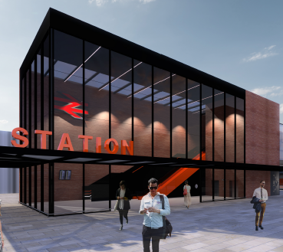
Questions

