Slide 1



Hampden Way, Barnet
Stakeholder Engagement

Slide 2
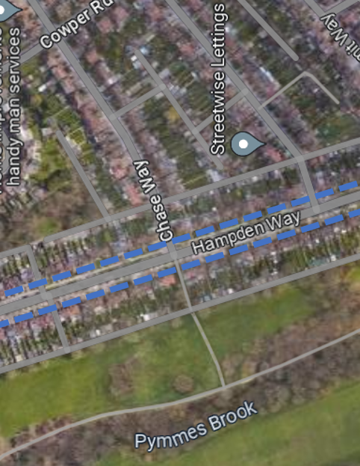
Site Information:
N14 5JP
Grid Ref Start: 528634, 194211
Grid Ref End: 528819, 193677
Hampden Way, Barnet–
Key Stakeholders:
Residents
Business owners
Emergency services
Nursery
Local authorities
TKJV

Slide 3
Stakeholder Engagement- Introduction
General Impacts​
Road Closures ​- Traffic to be diverted
Footway closures – pedestrians will be diverted locally on sections of carriageway
Buses on diverted route (more information in presentation)
Working Hours:​
Most of the work will take place Monday to Friday between 07:00 and 17:00 and on Saturdays between 07:00 and 14:00.
Phasing of works:
Works will be split into 5 main phases, to ensure works are managed effectively, all civil works will be completed within each phase- footway/ driveway reconstruction, kerbing & drainage.
Pedestrian movement will be maintained via diversion routes on carriageway
High impact/ sensitive locations – for example Nursey will be constructed during holiday period
Community Engagement Manager will be contactable (Monday to Friday) if there’s any issues or concerns raised. Additionally, there will be an out of hours number to contact

Slide 4
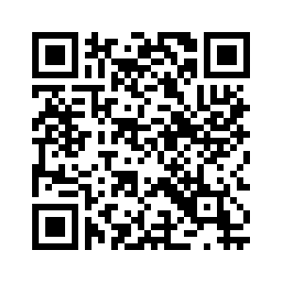
Communications
Key information to note around communications and engagement on Hampden Way, Barnet.
Community Engagement Manager will be located on the road in a cabin on Hampden Way four days a week from 9:30 AM to 17:00 PM. Location of cabin will be confirmed at a later date
Any concerns or issues with the works there is an email and telephone number: danielle.oconnell@kier.co.uk/ 07749576628
The out of hours number is 07749576628, please contact in case of emergency.
There will be a continuance of letter sent out around the progression of the works along Hampden Way. All residents, businesses will be updated two weeks prior.
For health and safety policy, only authorized professionals will have access to the site, and we be in PPE for the duration of the works. If you see someone who is not authorized without the correct PPE, please contact the number above.

Slide 5
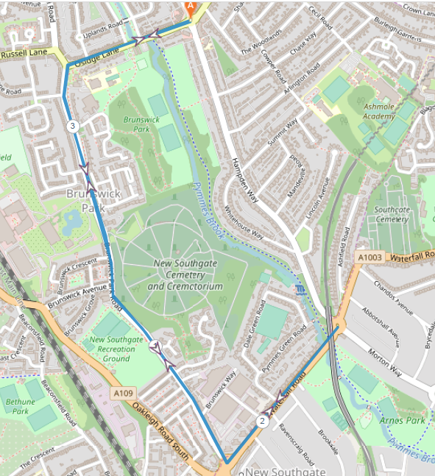
Diversion routes:
Local diversion route Local diversions will be in place via Waterfall Road, Brunswick Park Road and Osidge Lane. Bus route 184 towards Barnet, Chesterfield Road From Waterfall Road at the junction with Brunswick Park Road, right Brunswick Park Road, ahead Osidge Lane to line of route. Bus route 184 towards Turnpike Lane From Osidge Lane at the junction with Brunswick Park Road, ahead Brunswick Park Road, left Waterfall Road to line of route.

Slide 6
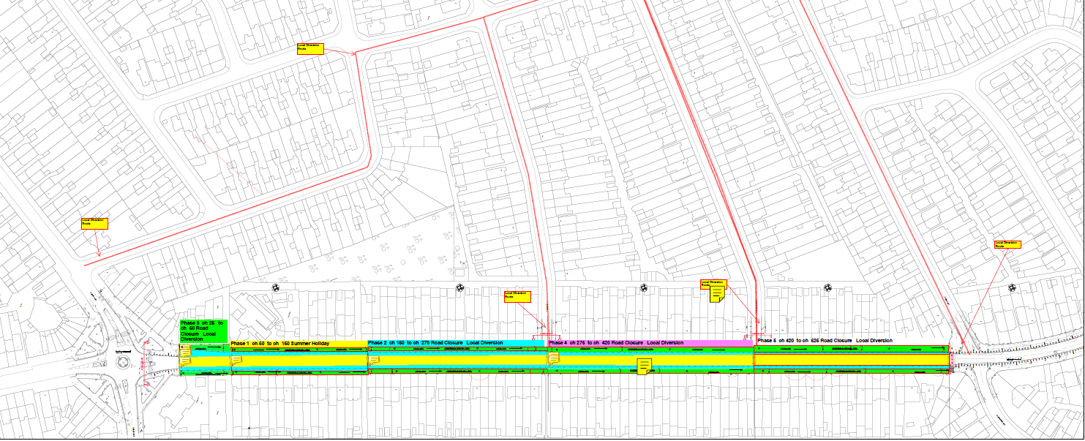
Phasing of Hampden Way
The carriage way reconstruction will be programmed and phased into 5 sections for approximately 9 months, weather permitting.
This is to ensure all works are carried out in a safe manner, and to completed to a high standard.

Slide 7
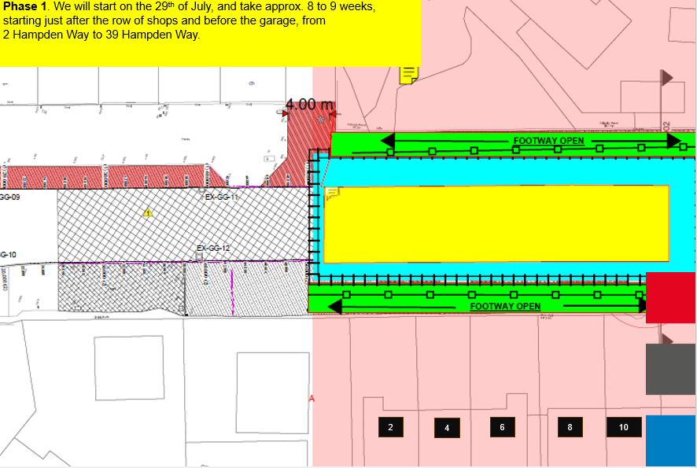

Slide 8
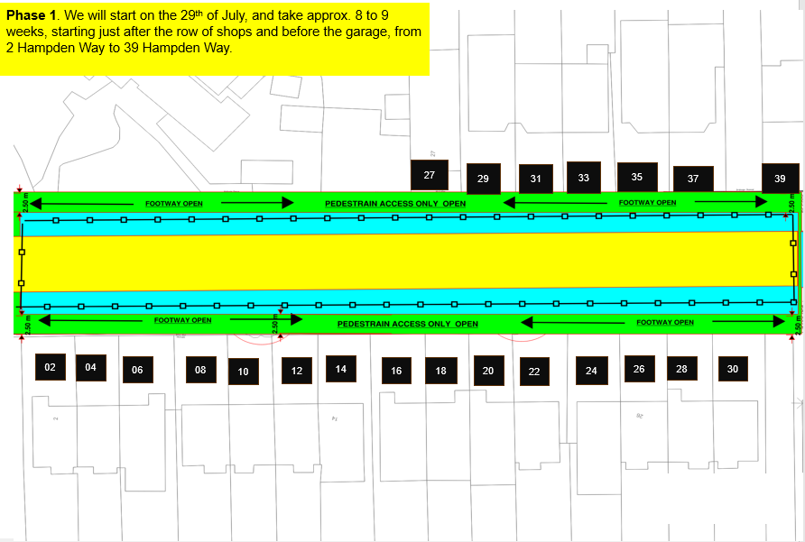

Slide 9
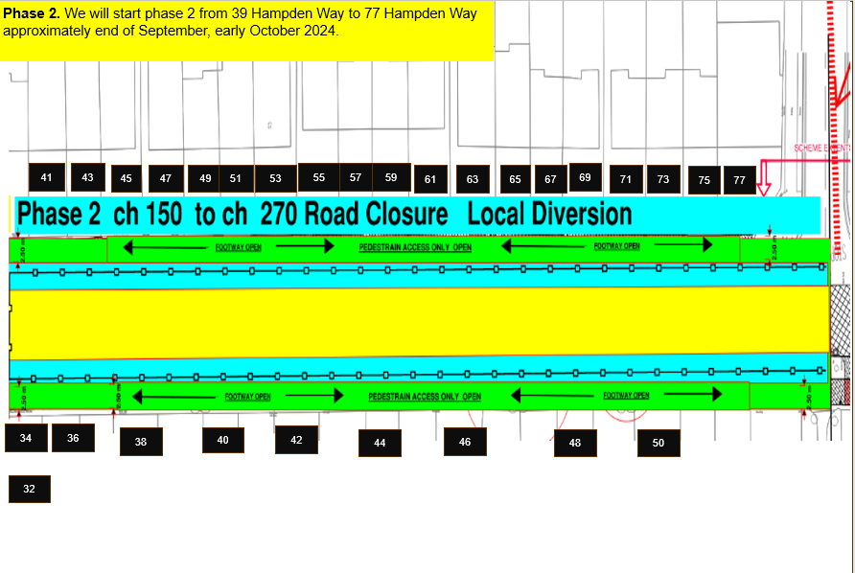

Slide 10
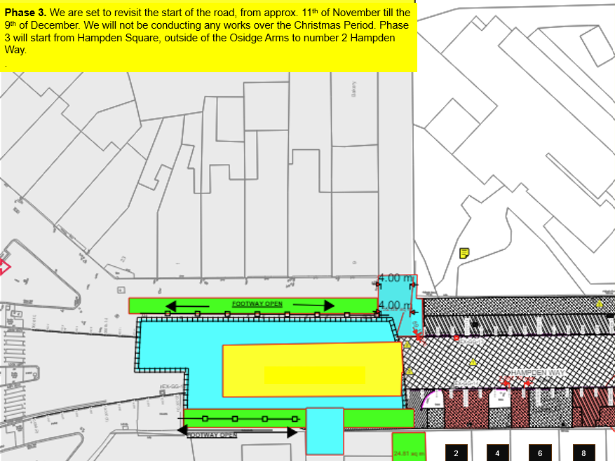

Slide 11
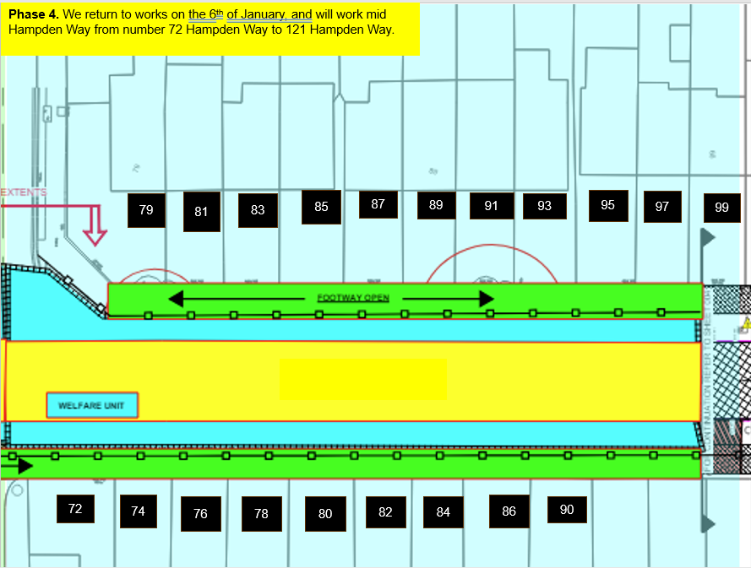
Phase 4. We return to works on the 6th of January, and will work mid Hampden Way from number 72 Hampden Way to 121 Hampden Way

Slide 12
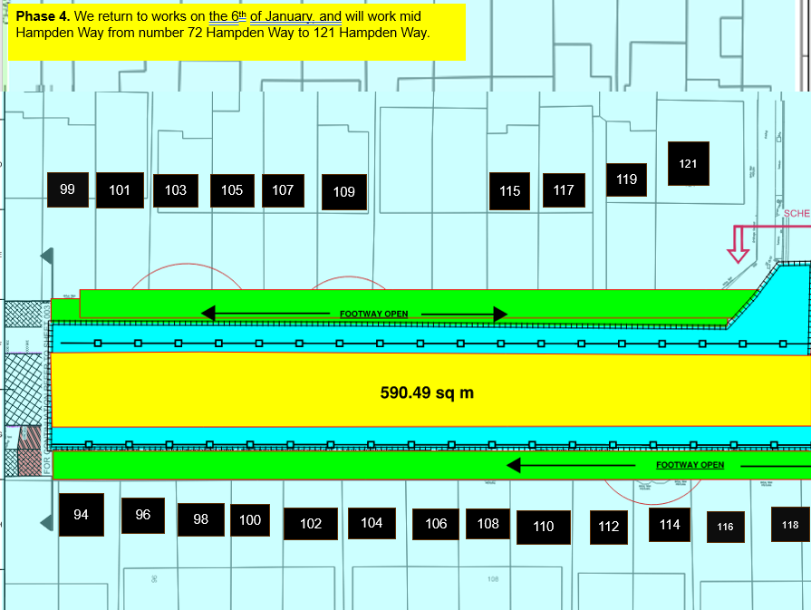
Phase 4. We return to works on the 6th of January, and will work mid Hampden Way from number 72 Hampden Way to 121 Hampden Way

Slide 13
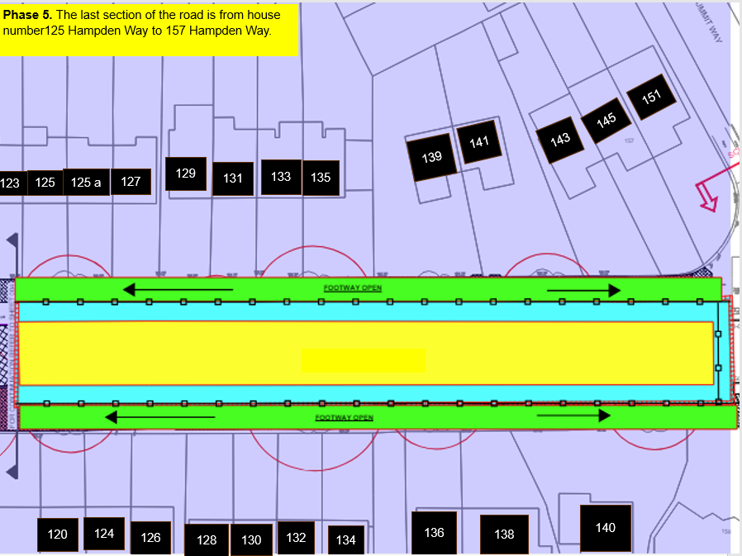

Slide 14

Any questions?

