Slide 1

Brent terrace residents forthcoming on-site activities update
07.02.19
Susie Wilson / Benoit Dufour
  BRENT
  CROSS
  SOUTH

Slide 2
Introduction
Objectives
To provide an update to Brent Terrace residents on on-going and forthcoming on-site activities within the Claremont Industrial Estate undertaken on behalf of LBB:
    Claremont Industrial Estate site security
    Existing Building and environmental surveys
    Clearance of Claremont Industrial Estate
    Utility disconnections
    Rosa Freedman and industrial units demolition works
    Considerate Constructors Scheme (CCS)
  BRENT
  CROSS
  SOUTH

Slide 3
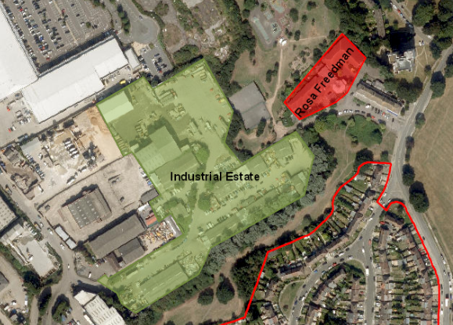
Site security
Two areas to be secured Post Vacant Possession/Pre-demolition works:
  Area 1 (Red) = Rosa Freedman
  Area 2 (Green) = Industrial Estate
Reasons:
  Mitigating risk of squatting / fly tipping
  Meter Removals / Utility disconnections
  Building surveys
  Additional ground investigations
  BRENT
  CROSS
  SOUTH

Slide 4
Site security
Current Works – Securing Rosa Freedman Centre and Industrial Estate
  BRENT
  CROSS
  SOUTH

Slide 5
Site security
Current Works – Securing Rosa Freedman Centre and Industrial Estate
  BRENT
  CROSS
  SOUTH

Slide 6
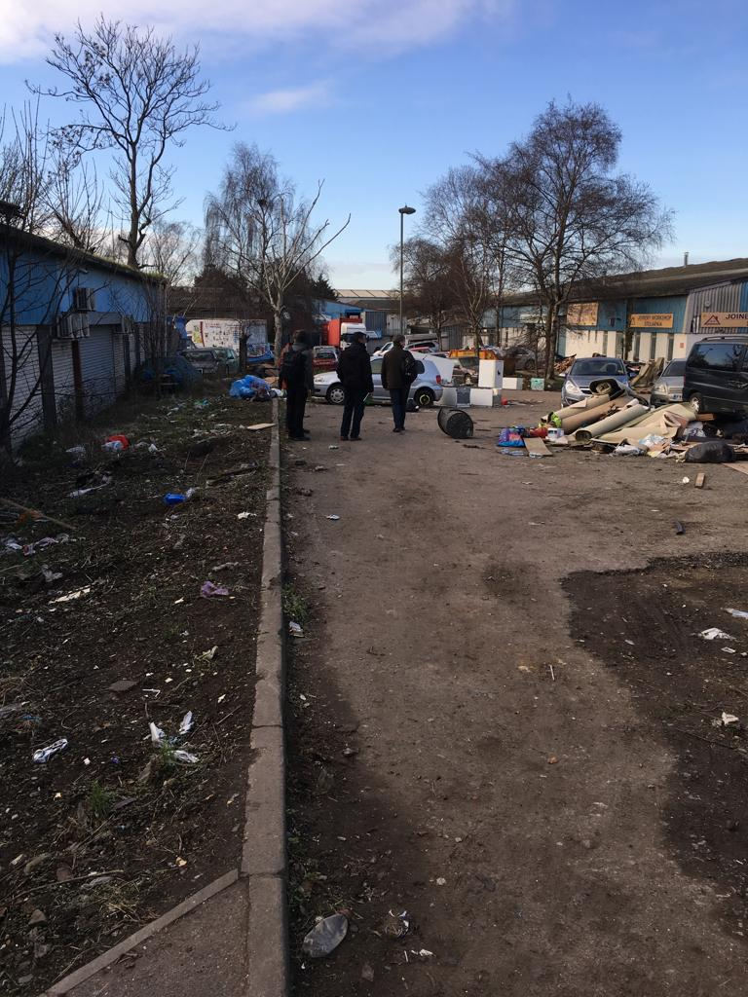
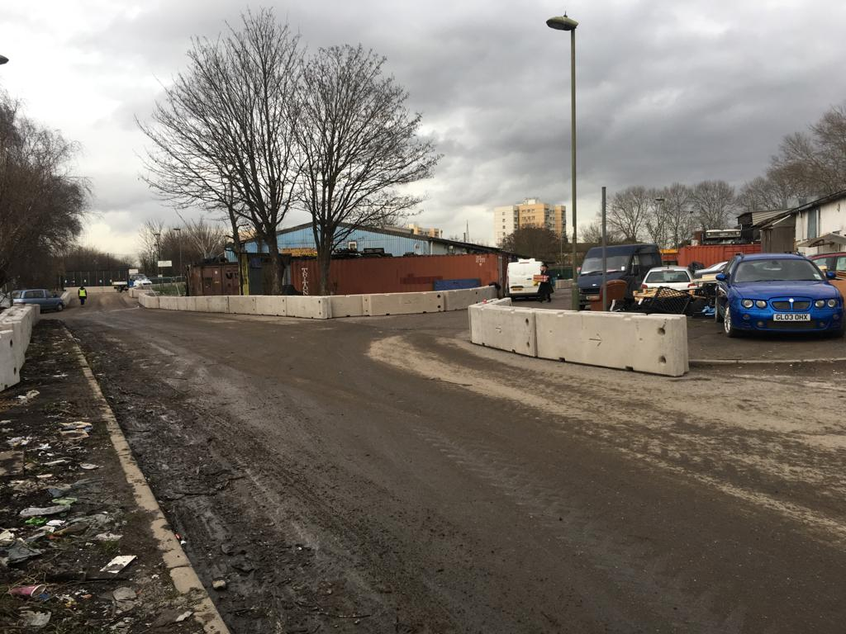
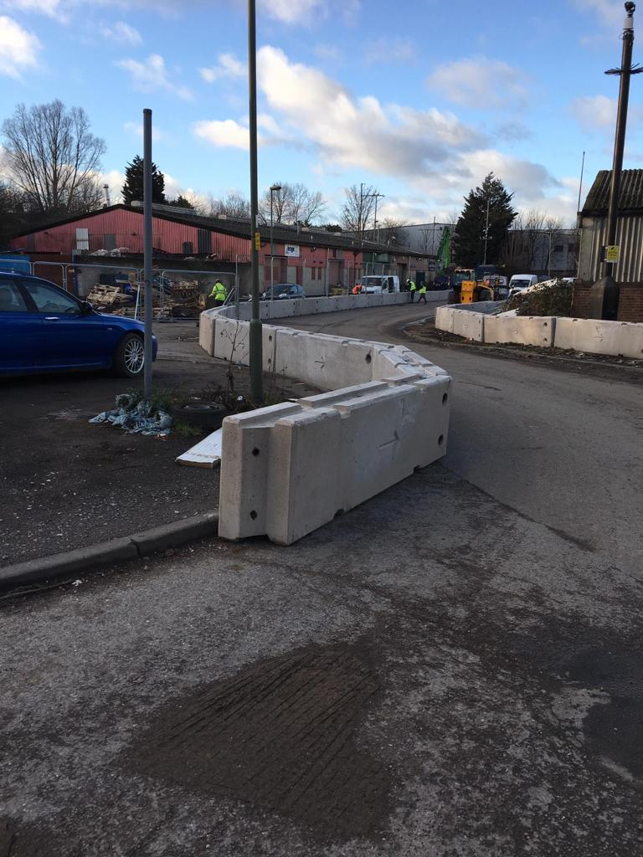
Site security
Current Works – Securing Rosa Freedman Centre and Industrial Estate
  BRENT
  CROSS
  SOUTH

Slide 7
Demolition works
  BRENT
  CROSS
  SOUTH

Slide 8

Considerate constructors scheme (ccs)
Infrastructure Contractor Selection
  Appointment of contractor in progress
  To be formally announced later in 2019
  Contractor willing to engage with local residents
Preferred contractor ensures all sites are registered prior to works commencing – key selection criteria from BXSLP
Multiple Gold awards won for their performance under CCS Scheme
  BRENT
  CROSS
  SOUTH

Slide 9
Considerate constructors scheme (ccs)
CCS Scheme covers:
General Public
  Reduce any negative impact on local areas and residents
  Aim to leave a positive impression on those affected
Environment
  Reducing negative effect
  Working in environmentally and sustainable manner
  Impacts to be evaluated and mitigations implemented to minimise pollution
  Reduce / re-use / recycle waste
  Materials from sustainable sources
Workforce
  Provide clean and appropriate facilities for workers
  Facilities to be comparable to any other working environment
  BRENT
  CROSS
  SOUTH

Slide 10
Thank you.
Any Questions?
  BRENT
  CROSS
  SOUTH

