Slide 1
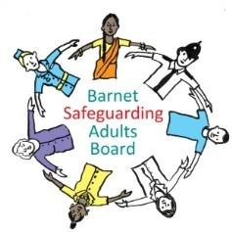
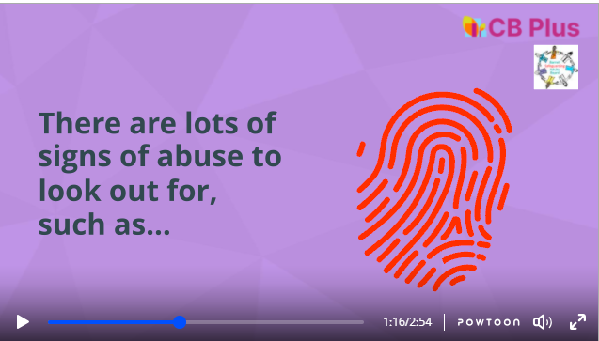
Prevention Fund – Reframing Safeguarding (£20k)
WHAT DID THE PROJECT DO?
The project aimed to promote understanding about safeguarding amongst Barnet’s diverse communities
Led by a task group sitting under the Barnet Safeguarding Adults Board, the project delivered:
  Initial engagement programme consisting of focus groups, face-to-face conversations, social media campaign, survey to scope understanding. This focussed on working with residents and community groups working with protected and/or at-risk users
  Deliver a community safeguarding information for people and organisations on how to effectively safeguard adults
WHAT HAS BEEN ITS IMPACT?
57 participants took part in the focus groups undertaken by CB Plus, plus 30 individuals/organisations filled in the online survey
CB Plus also raised the profile of Safeguarding through local community events. The programme was promoted through several community events including Hub Connections, Mental Health Awareness Day, Purple Tuesday, and Black History Month.
Approximately 800 people attended the events held at Brent Cross, Meritage Centre, and Burnt Oak Leisure Centre, and 500+ organisations have been reached via outreach events
Online video explainer has been produced for use in future events -CB Plus Safeguarding Video V2
Next steps identified in the research have been included in the BSAB work plan and assigned to two sub-groups for action
WHAT HAVE WE LEARNT?
Through the focus groups and survey, we have found a variety of different aspects:
The term safeguarding did not always have an equivalent in other languages or cultures
Differing attitudes as to whether people feel comfortable in reporting safeguarding issues.
Barnet Mencap group identified that they wanted more information about preventing financial abuse
Suggestion on develop a codeword which could be used in local shops which could be used to alert people that an individual needed help
WHY IS IT IMPORTANT?
Barnet communities have become more diverse over time (Source: Barnet JSNA)
The Performance Quality Assurance subgroup of the Safeguarding Adults Board regularly reviews performance information from organisations on safeguarding
However, there was a gap identified in this area around community knowledge and confidence in this area, which this project would provide
Project Lead:
Joyce Mbewe, Safeguarding Adults Board Business Manager, joyce.mbewe@barnet.gov.uk

